Slide 1
Lab 11 Advanced SQL 1
United International College
COMP3013 DBMS

Slide 2
Outline
Constraints
Integrity Constraints
Check Clauses
Referential Integrity
Keys and Referential Integrity
Cascading actions in referential integrity
Assertions

Slide 3
General Remarks
The references in this lab refer to the 7th edition of the textbook. Please see the referenced sections for more explanations.
For the examples and exercises, you are to alter the structures of tables in the uic_without_foreign_keys.sql database.
This database is same as the solution of lab 6 and 7, but without any foreign keys. We will recreate them today.
Download “uic_without_foreign_keys.sql” from iSpace and import it to MySQL.

Slide 4
Integrity Constraints
Reference [4.4] Integrity Constraints
A database “lost its integrity” means it’s damaged and not functioning properly.
Similarly a ship “lost its integrity” means it’s damages and cannot sail properly.
Integrity constraints guard against accidental damage to the database, by ensuring that authorized changes to the database do not result in a loss of data consistency.
We declared these constraints in student
gpa must be from 0.0 to 4.0

Slide 5
The Check Clause
Run this query with an illegal GPA. What happens?
INSERT INTO student (id, s_name, yr, gpa, p_code)
VALUES (30010, 'Wonderland', 3, 5.00, 1003)
The tuple is inserted normally.
Delete this row with illegal value you’ve just created. We will create some constraints to ban the illegal insertions.

Slide 6
The Check Clause
The check clause has the form CHECK(P), where P is a predicate. The condition specified by the predicate must be held by the database.
Example: ensure that the GPA of a student is between 0.00 and 4.00.
ALTER TABLE student
ADD CONSTRAINT gpa_domain
CHECK (gpa>=0.00 AND gpa<=4.00)
ALTER TABLE is used to change the structure of an existing table.
ADD CONSTRAINT is used to add a new constraint, followed by the constraint name, which user defined.
CHECK (…) is the body of the constraint.
Try to insert a student of GPA higher than 4 after adding the constraint and see what will happen.

Slide 7
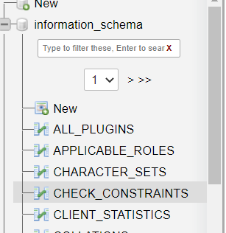
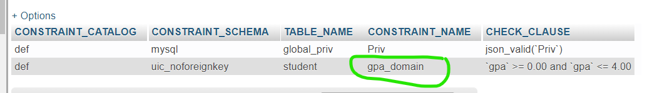
The Check Clause
In In the DB navigation tree (above the databases) open information_schema > CHECK_CONSTRAINTS.
The constraint gpa_domain appears.
Now run the ALTER TABLE query with the illegal value (from last slide).
You should get an error message.
If you need to remove the constraint, do
ALTER TABLE `student`
DROP CONSTRAINT `gpa_domain`

Slide 8
Referential Integrity
Reference [4.4.5] Referential Integrity, [1.4.2 p11] Data-Definition Language
Referential integrity ensures that a value that appears in one relation table for a given set of attributes must also appears in the corresponding set of attributes in the other relation table
E.g. if p_code 1001 is the program code for a row in table student, then there must be a tuple in the corresponding table program for p_code 1001. The structure of program is as below.
CREATE TABLE program( p_code INT(11) NOT NULL, p_name VARCHAR(40) NOT NULL, division VARCHAR(40), director_id INT(11), PRIMARY KEY (p_code)
)

Slide 9
Cascading Actions in Referential Integrity
Reference [4.4.5 p133] Referential Integrity
Consider the child table student, which references the parent table program
CREATE TABLE student ( … p_code INT(11),
FOREIGN KEY (p_code) REFERENCES program(p_code), …
)
CREATE TABLE program (
… p_code INT(11) NOT NULL, PRIMARY KEY (p_code),
… )

Slide 10
Cascading Actions in Referential Integrity
If a row in table program is deleted or updated, that might cause integrity problem in the table student.
To solve this problem, use cascade action. When a change is made in the parent table program, the corresponding value in the child table student is also changed.
Again, because the table student already exists, we need to alter the table.
ALTER TABLE student
ADD CONSTRAINT student_program
FOREIGN KEY (p_code) REFERENCES program(p_code)
ON DELETE CASCADE
ON UPDATE CASCADE
Alternative cascade actions can be: SET NULL and SET DEFAULT.
When the value in the parent is changed, the corresponding child value is set to null or the default value.

Slide 11
Cascading Actions in Referential Integrity
Before you add the cascade constraint in the last table, remove a student from the table student.
You will get no error message.
Add back the student you’ve deleted.
Run the cascade constraint in the last slide.
Don’t forget to add the back tic `
Now delete a student and check the outcome in the table enroll.

Slide 12
Exercises
Using the UIC database, write a MySQL query to implement the following constraints.
The grade of each enrollment is one of A, A-, B+, B, B-, C+, C, C-, D, F.
The year of each student is between 1 and 4.
Recreate the foreign keys for each table except borrow.id (and contact.id)refereeing to student.id and instructor.id.
When one row in parent table is changed, the corresponding row in the child table also should be changed.
Save your queries in a txt file. Rename it as “COMP3013 Lab11 ###.txt”, where “###” is your student ID. And submit it on iSpace. The DDL is 24 hours after the lab.

Slide 13
End of Lab 11

